Slide 1

Progress Presentation 1

Slide 2

How to mitigate botnet attacks
IT17009614 - A.M Isuru Srimal Abeykoon

Slide 3

Introduction to the Component
Implementing proper mechanism mitigate botnet attacks and develop host-based IDS to keep botnets from taking root in the system. Therefore,
Botnet Prevention System (BPS)
Packet Capture Module
Network Traffic Monitor (UI)

Slide 4
1. Botnet Prevention System (BPS)
Identify common issues of IOT
Machine Learning
Feature Extraction
Anomaly Detection

Slide 5

Identify Common Issues of IOT
Mirai
BASHLITE

Slide 6
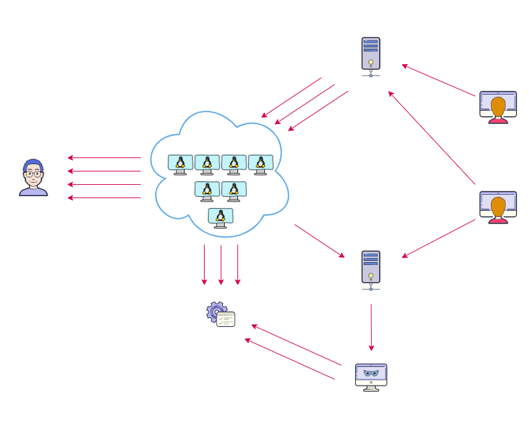
Mirai
SYN Port Scan
Brute Force Authentication
Report Success

Slide 7
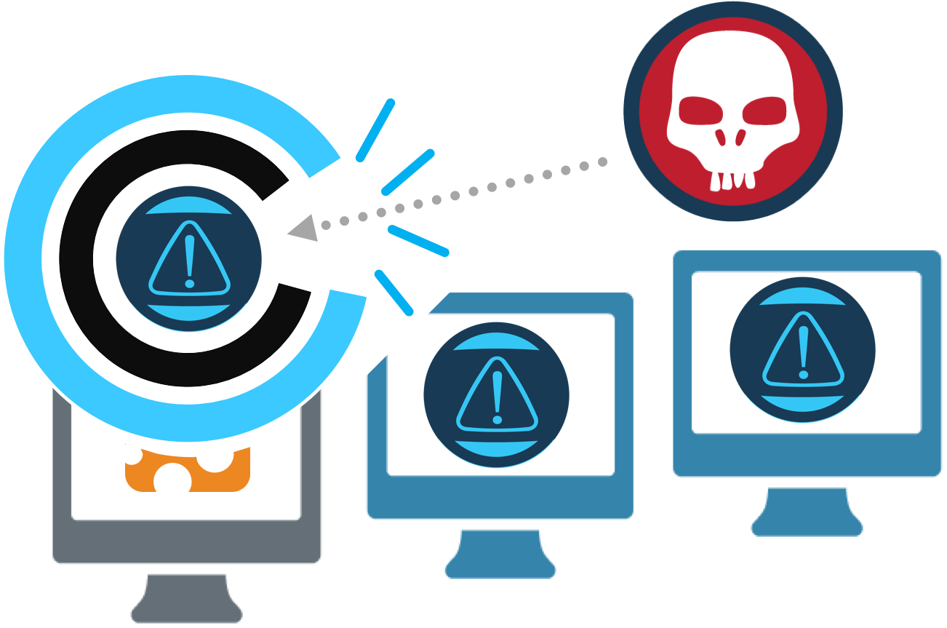
BASHLITE
Tampering the /etc/rc.local file
Aiming to survive a device reboot
Agent-Handler based

Slide 8
1. Botnet Prevention System (BPS)
Identify common issues of IOT
Machine Learning
Feature Extraction
Anomaly Detection

Slide 9
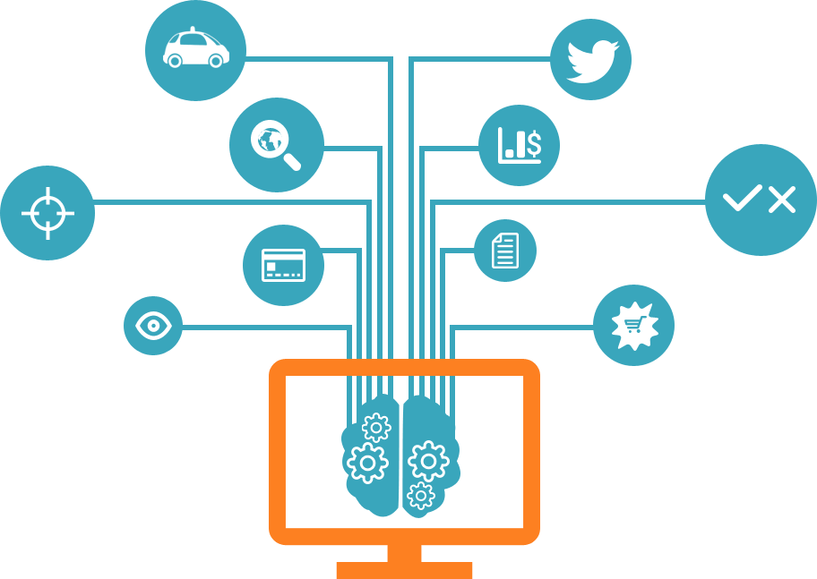
Machine Learning
Data Analytics
Machine Learning Algorithms

Slide 10

Data Analytics
Improving the design
Clarifying information
Quantify and track objectives

Slide 11
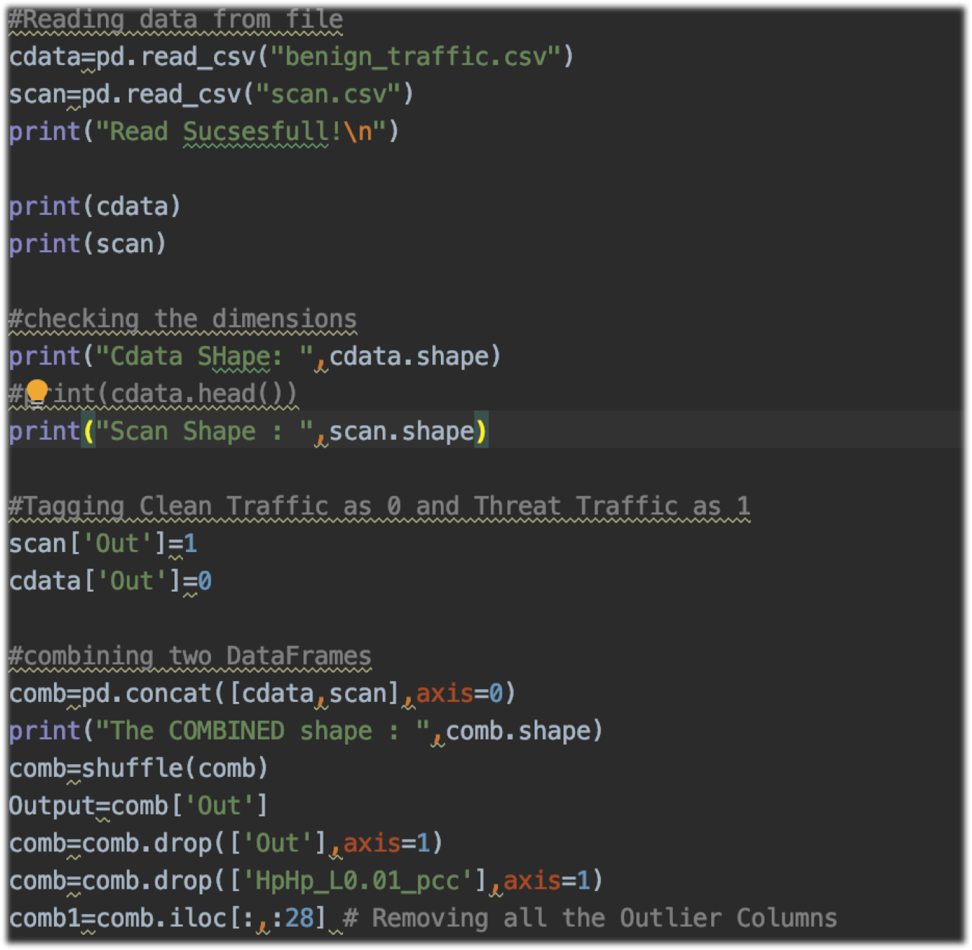
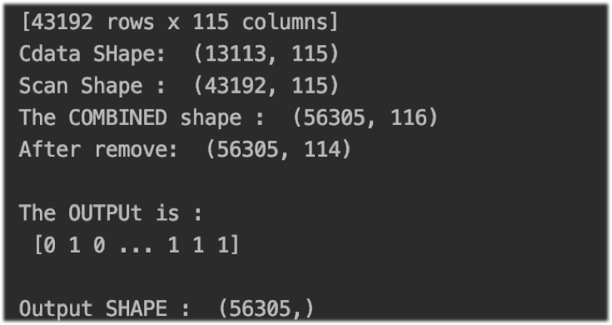
Results
CTU-13-Dataset
Script

Slide 12

Machine learning algorithms
Decision Tree
Logistic Regression
Perceptron
Naïve Bayes
K-Nearest Neighbours (KNN)

Slide 13
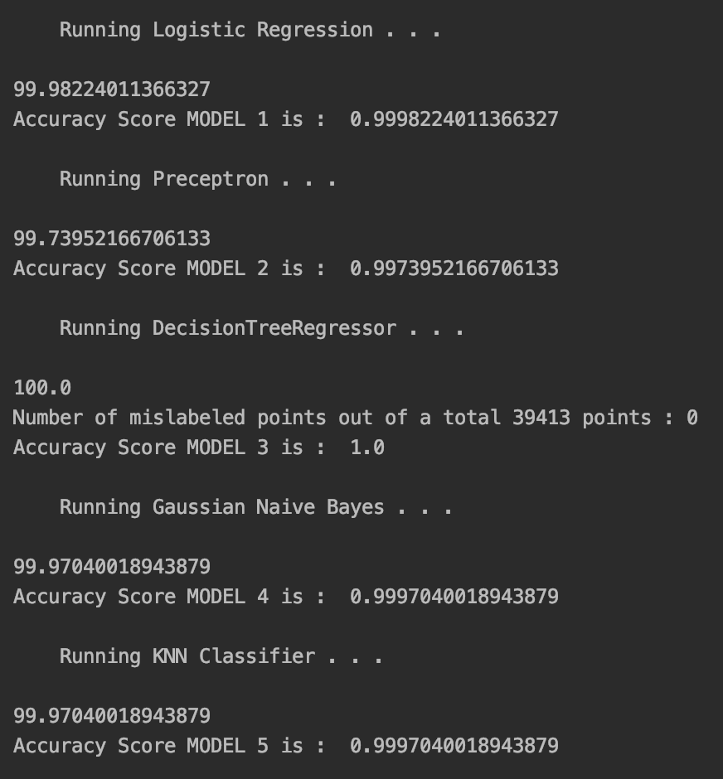
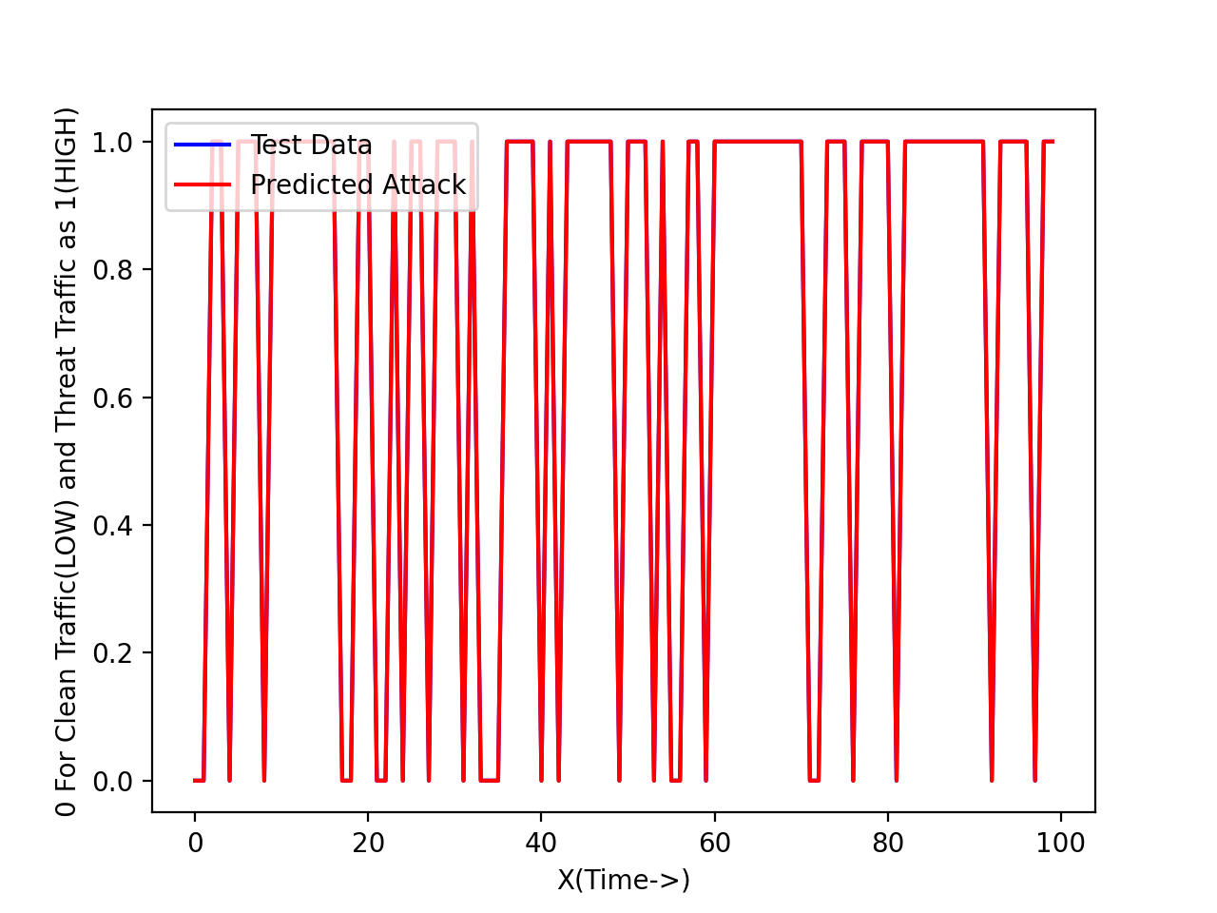
Results

Slide 14
1. Botnet Prevention System (BPS)
Identify common issues of IOT
Machine Learning
Feature Extraction
Anomaly Detection

Slide 15

Feature Extraction
Create the instance (x vector)
Packet size
Packet count
Packet jitter

Slide 16
Results
Value | Statistic | Aggregated From | Number of Features
Packet Size (Incoming Packets) | Mean Variance | Source IP Source MAC | 8
Packet Count | Number | Source IP Source MAC Channel Socket | 4
Packet Jitter | Mean Variance Number | Channel | 3
Packet Size (Incoming and Outgoing Packets) | Magnitude Radius Covariance Correlation Coefficient | Channel Socket | 8

Slide 17
1. Botnet Prevention System (BPS)
Identify common issues of IOT
Machine Learning
Feature Extraction
Anomaly Detection

Slide 18

Anomaly Detection
Feature Mapping
Auto-encoders
Power Grids

Slide 19
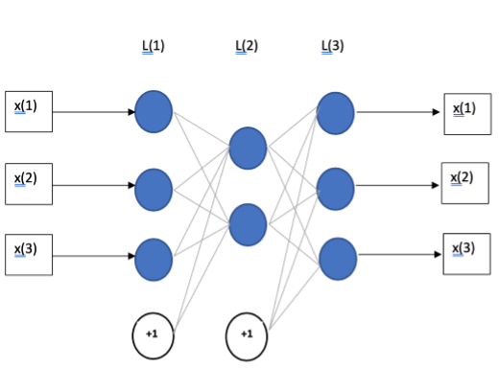
Auto-encoder with a single compression layer

Slide 20
1. Botnet Prevention System (BPS)
Identify common issues of IOT
Machine Learning
Feature Extraction
Anomaly Detection

Slide 21

2. Packet Capture Module
Packet Capturer
Packet Parser
Feature Extraction

Slide 22
Current Achievement
Botnet Prevention System (IDS)
Packet capture module
Network traffic monitor (UI)

Slide 23
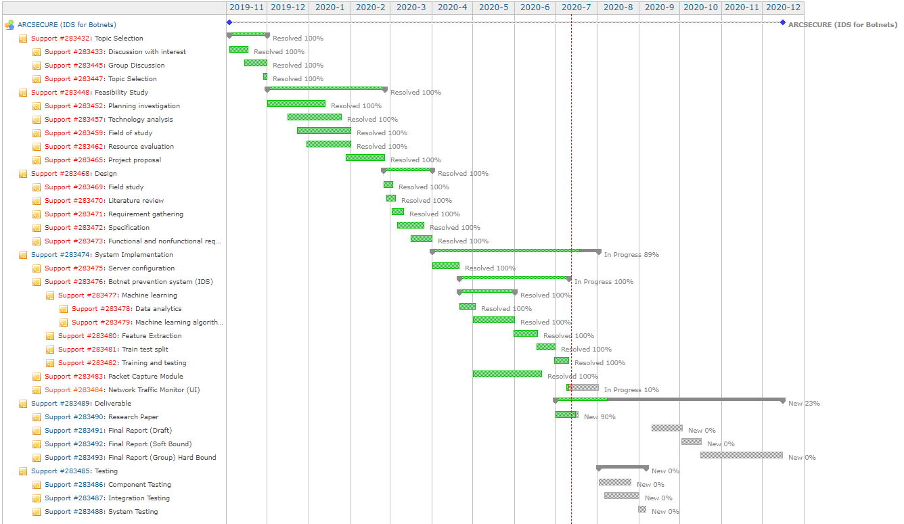
Current Progress
Gantt chart

Slide 24
Detecting and mitigating DoS Attacks
IT17127356 - A.M.S.P.B ATAPATTU

Slide 25

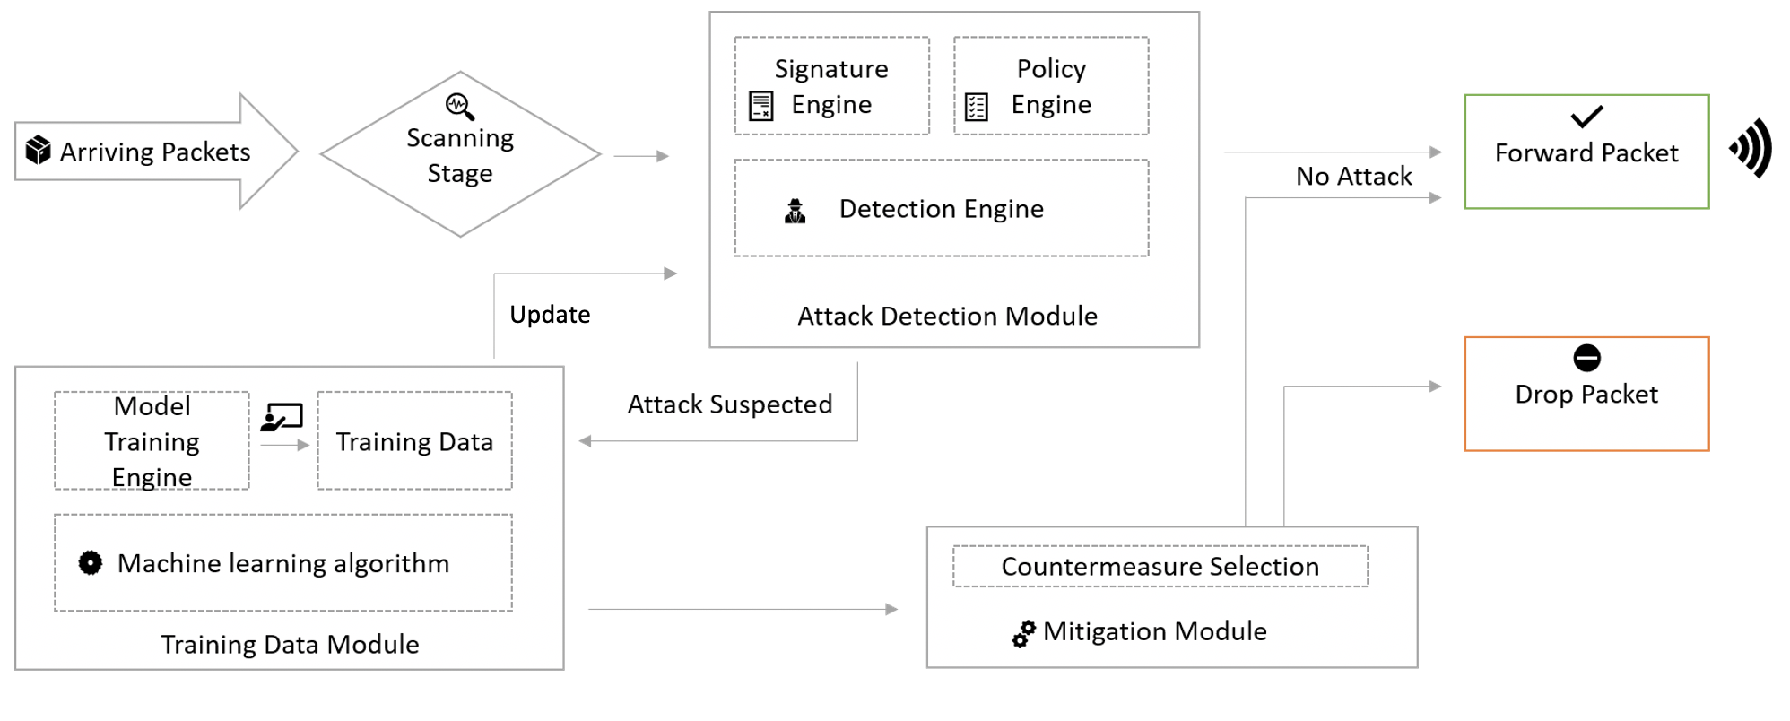
Ensure IoT DoS and DDoS attack detection, mitigation
Create a way to simulate DoS attack and gather data and develop machine learning algorithm and train it using gathered information to identify DoS attack and create a way to mitigate
Machine learning based framework for DDoS attack detection and mitigation
Attack Detection
In this stage all incoming packets are scanned and checked for any malicious content
Training Data
If any data packet is attack suspected will be forwarded to here to train the machine learning algorithm
Mitigation
Dropping malicious network packets or forward
1. Arriving Packets
2. Attack detection module
3. Training data module
5. Forward or Drop
4. Update Rules

Slide 26
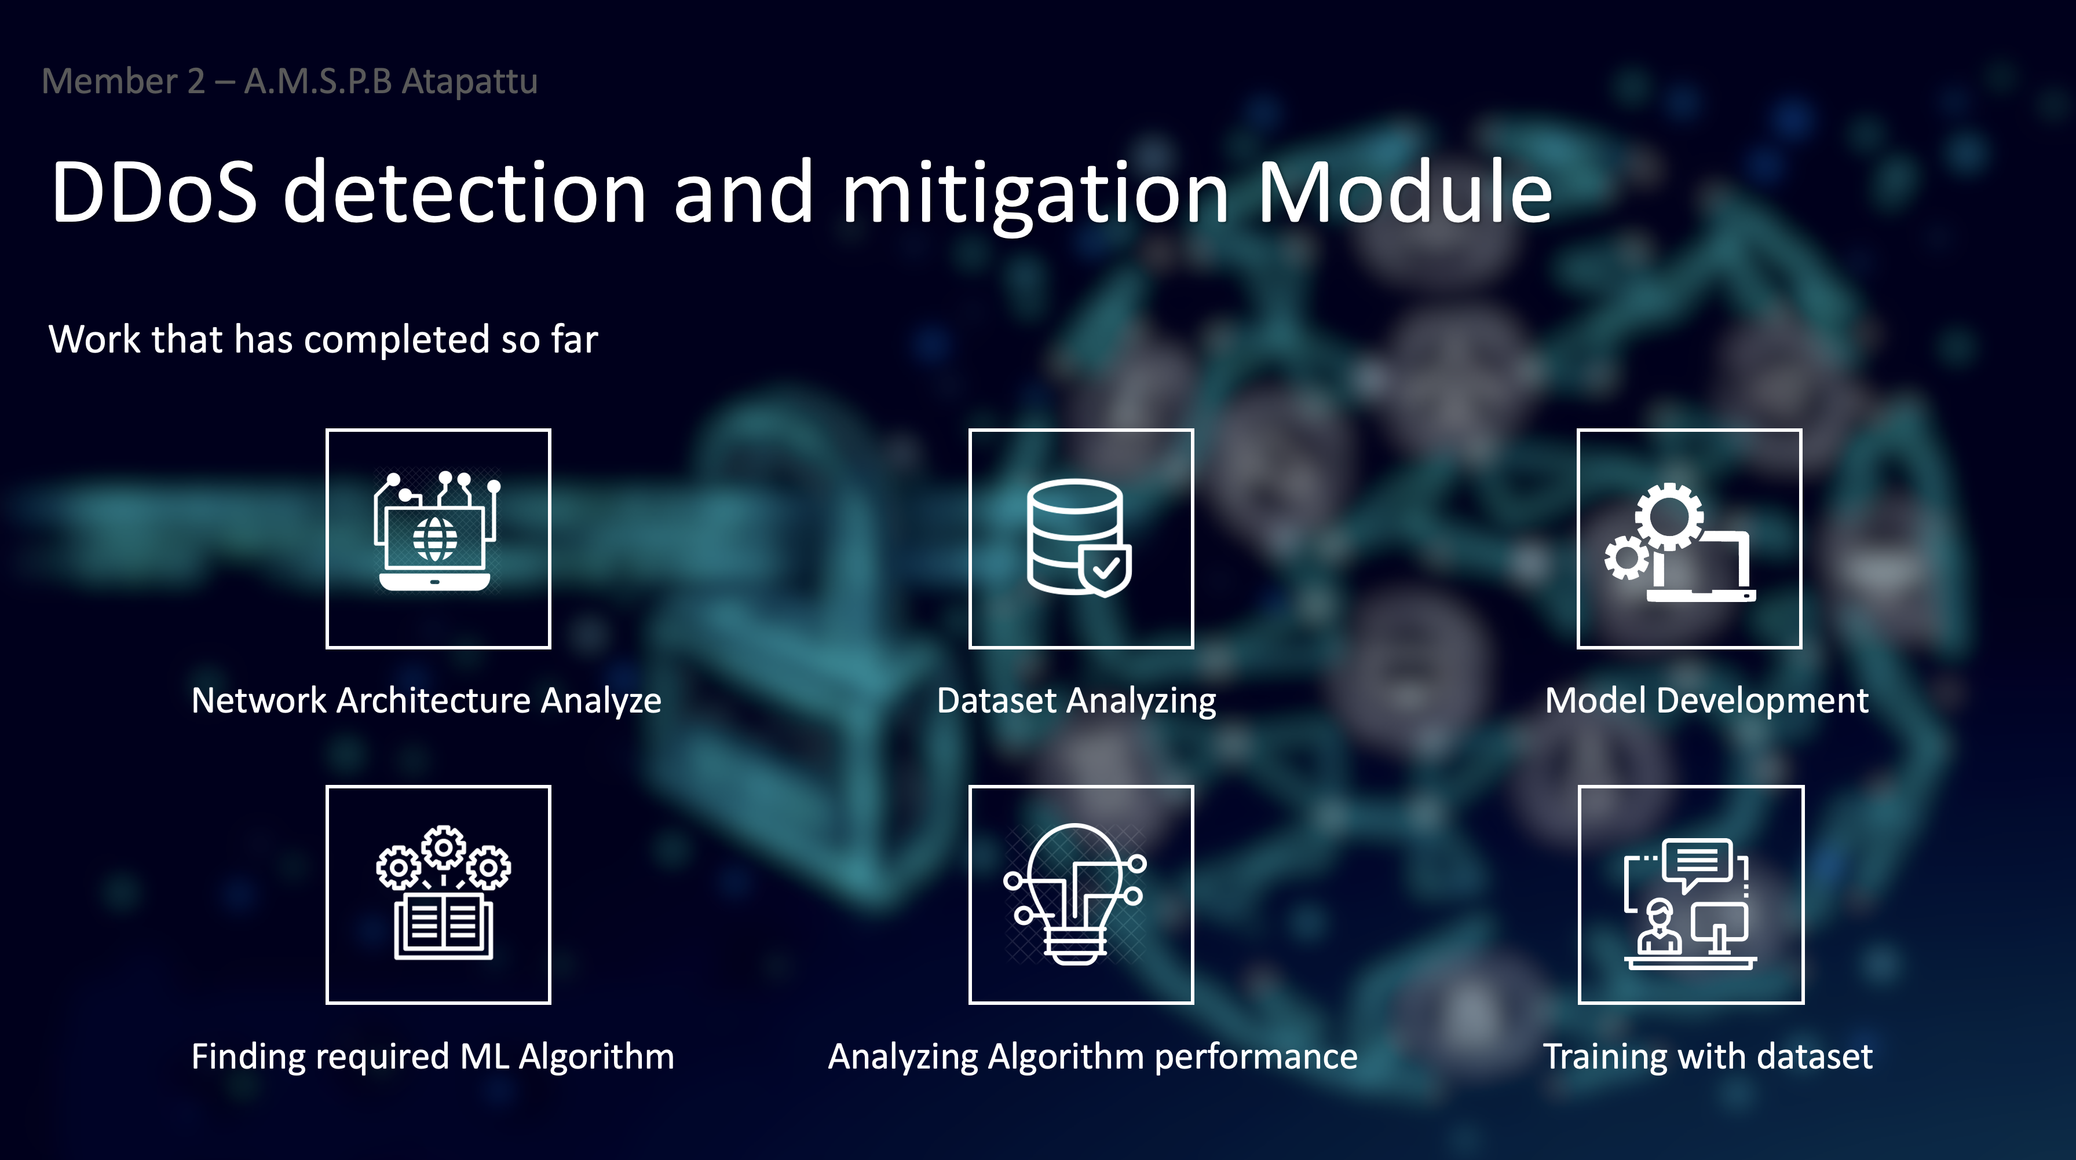

Slide 27



IoT Architecture
Networked things
Sensor data aggregation systems and analog-to-digital data conversion
Analysis, management, and storage of data
Network
Architecture
Analyse

Slide 28
Machine learning algorithms
Logistic Regression
Standard Feedforward
Random Forest
Support vector machine

Slide 29
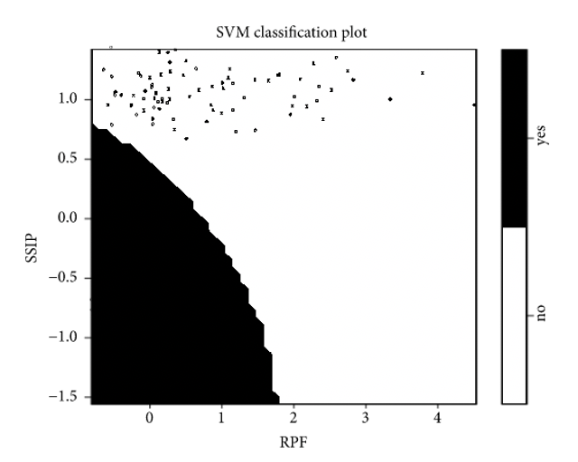
Results
Algorithm | Accuracy % | True Positive % | False Positive %
Logistic Regression | 91.14 | 93.63 | 12.50
Standard Feedforward | 89.87 | 95.74 | 18.75
Random Forest | 91.14 | 93.62 | 12.50
SVM | 93.67 | 91.49 | 03.10

Slide 30
Model Development
The whole point being to end up with a usable hardware implementation, it is impossible to afford more than a few milliseconds for each packets on a rather weak machine And take the time to benchmark the performance of other well-known algorithms.

Slide 31
SVM Training Parameters
Speed of source IP
Standard deviation of flow packets
Standard deviation of flow bytes
Speed of flow entries
Ratio of pair-flow entries

Slide 32
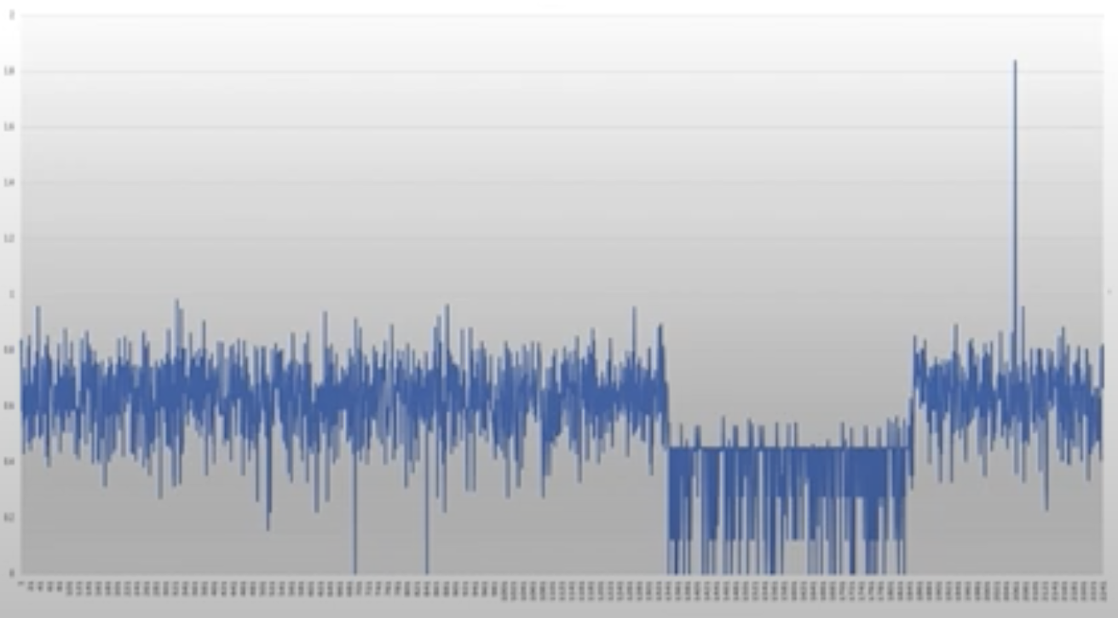
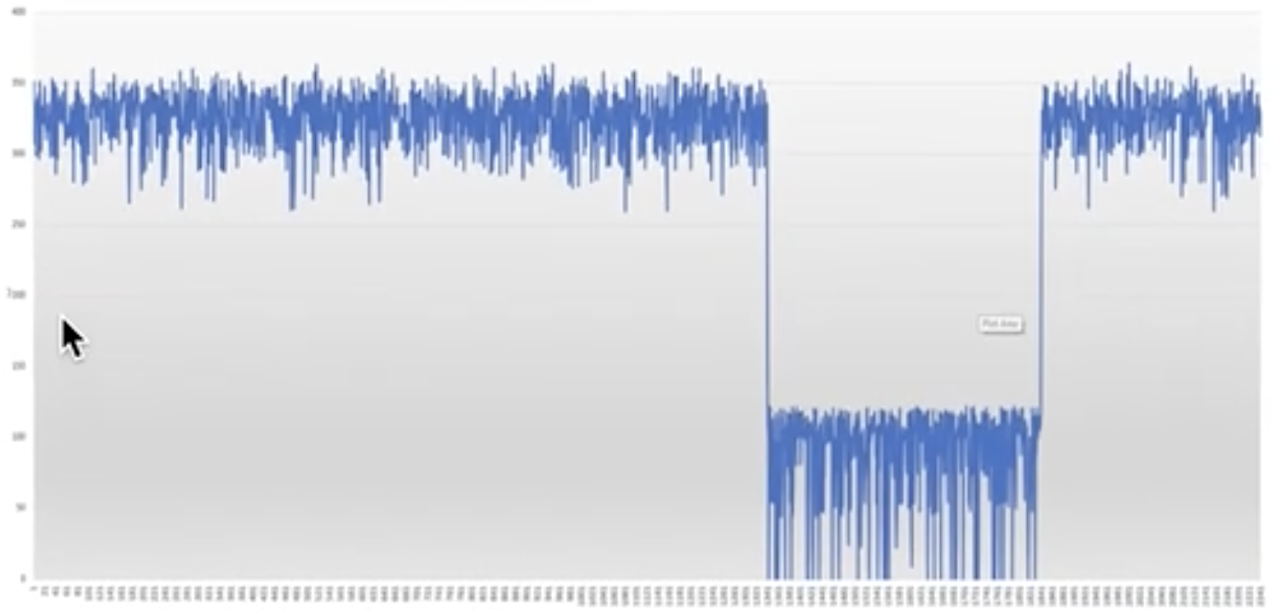
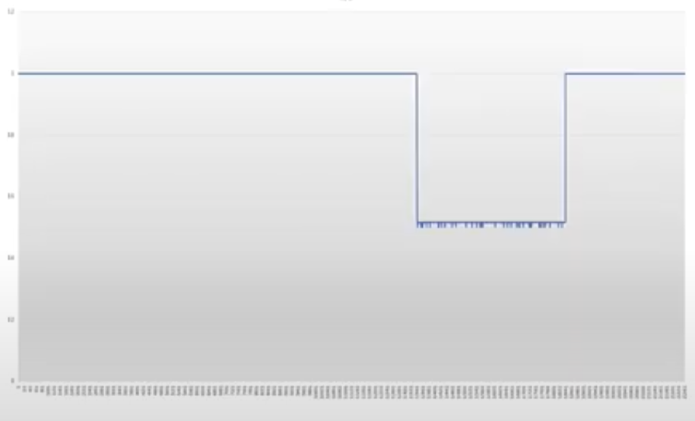
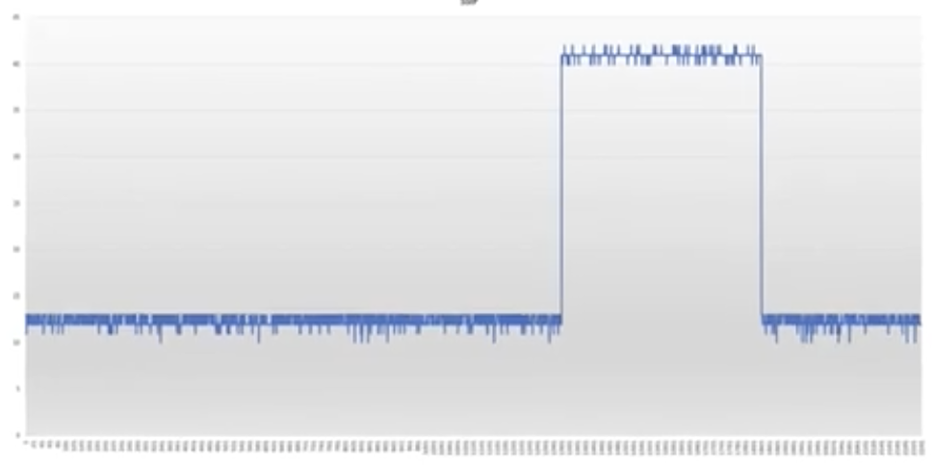
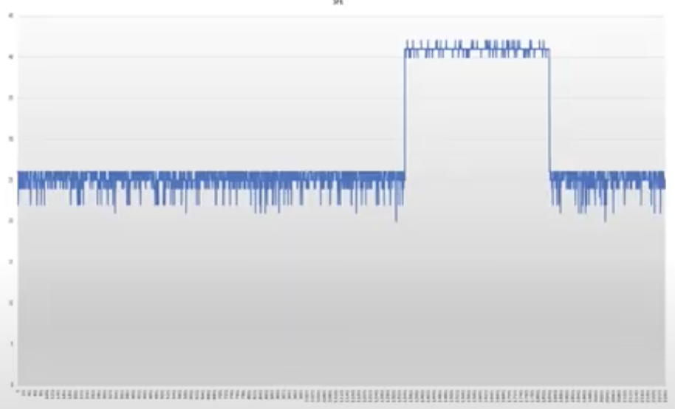
Results
Standard deviation of flow packets
Standard deviation of flow bytes
Ratio of pair-flow entries
Speed of source IP
Speed of flow entries

Slide 33
Training With Data Set
Incoming packets are first captured and then the required features are extracted.
The extracted features are fed into the DDoS classifier, which is an ensemble model consisting of consists ML classifiers.
If the batch of packets is classified as ‘class 1’ or ‘safe’, they are forwarded to the target server without any further processing.
The results of SVM is trained based on the parameters and figure shows the result of SVM classifier

Slide 34
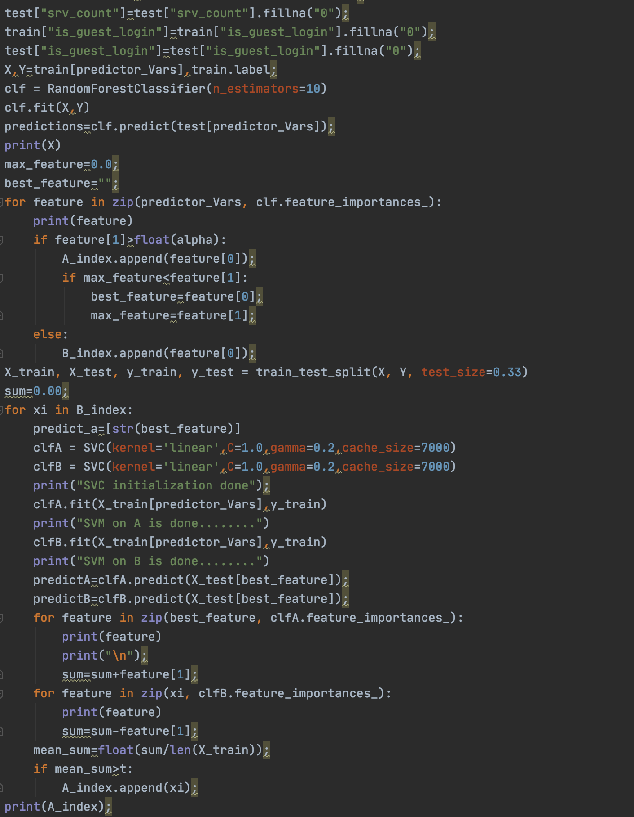
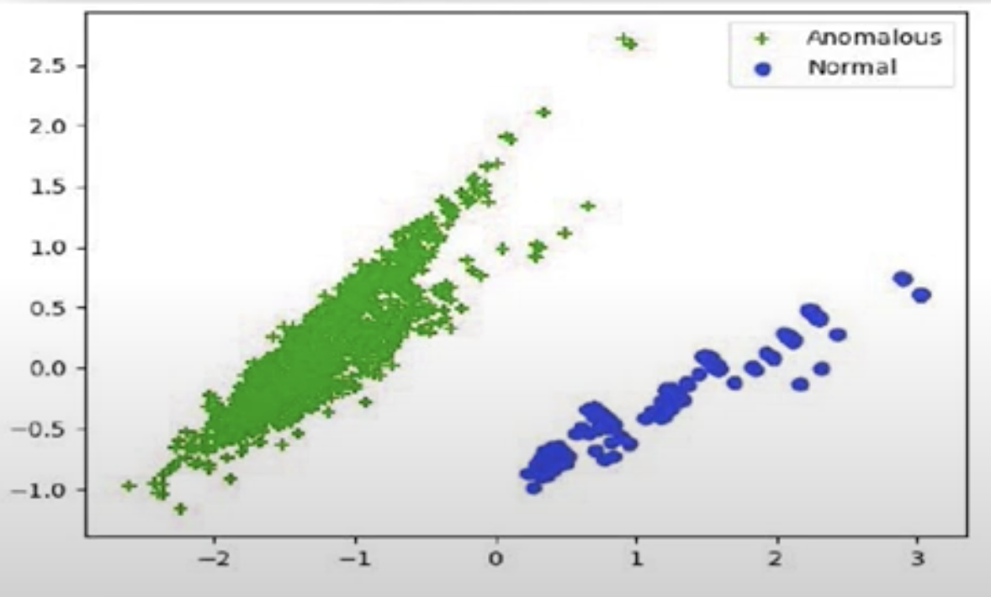
Results
Script
Trained Chart

Slide 35
Achievements
Network Structure Analyzing
Model Development
Conduct Algorithm Performance
DoS Detection System Implementation
Networking Monitor UI Development

Slide 36
Malware Detection
Jayawardhane H.N - IT17078306

Slide 37
Malware Detection - Jayawardhane H.N (IT17078306)
When the user is initially installing the particular application/software of the device which he/she has newly bought, there is tendency where he might download a corrupted file which might contain malware and in return will put the user’s device’s security in jeopardy. Hence it is also important that the user installs the correct version of software on his/her device.
Therefore, in order to do that a Machine Learning model will be used to make sure that the software that the user is installing is in fact the correct version provided by the developers.

Slide 38
Technologies used
PyCharm IDE
Python
Flask
Pickle

Slide 39
Methodology and Implementation

Slide 40
Methodology
For this purpose 5 supervised learning algorithms were chosen. Namely,
Decision Tree
Random Forest
Gradient Boosting
Adaptive Boosting
GNB

Slide 41
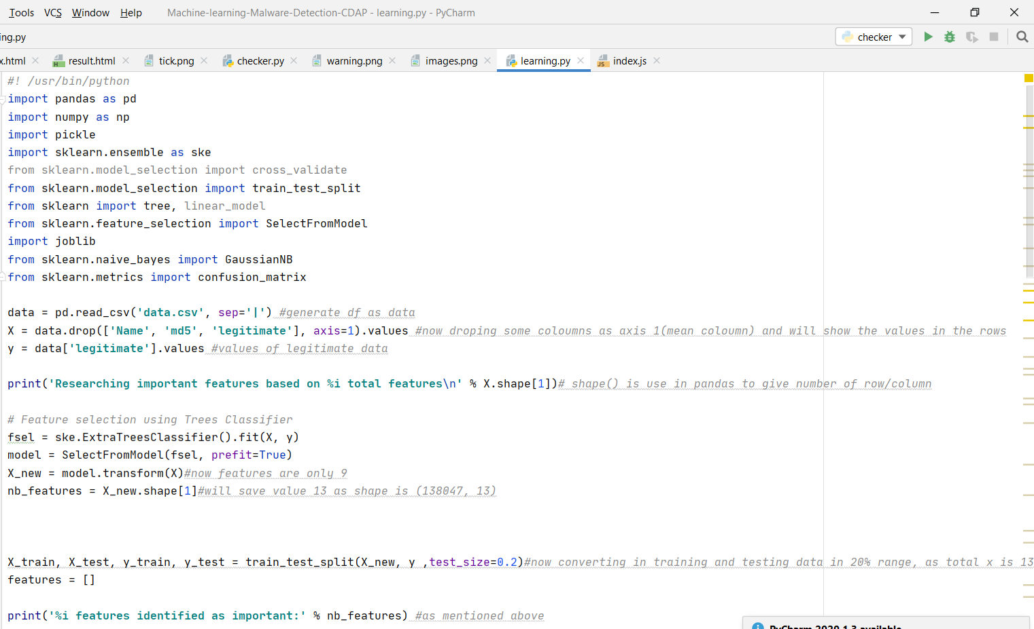

Slide 42
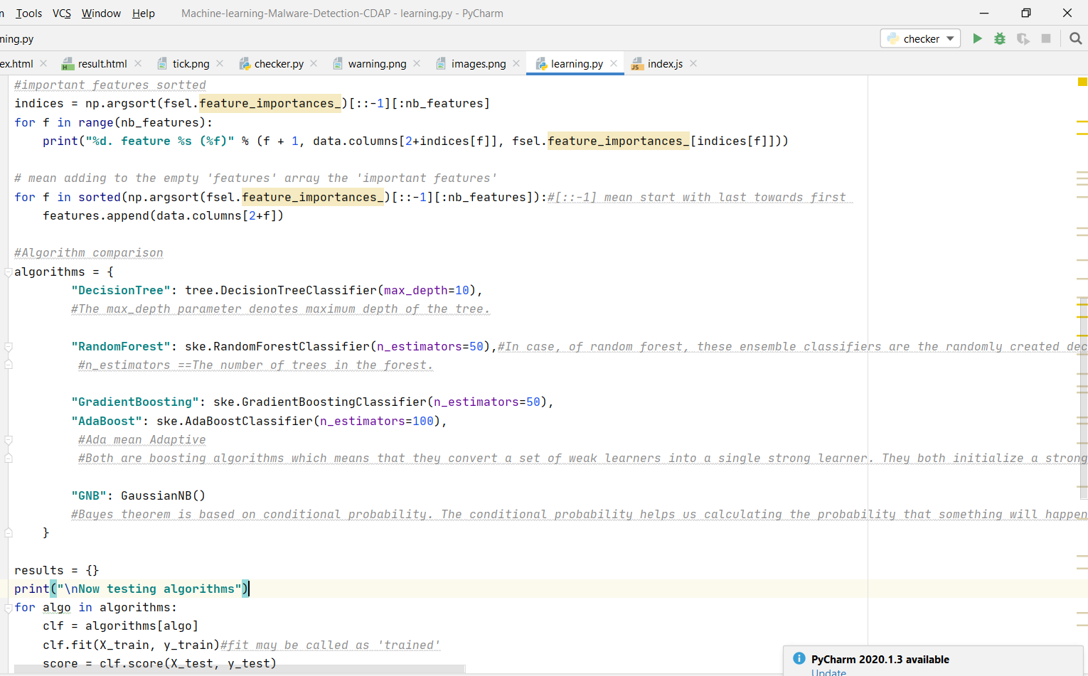

Slide 43
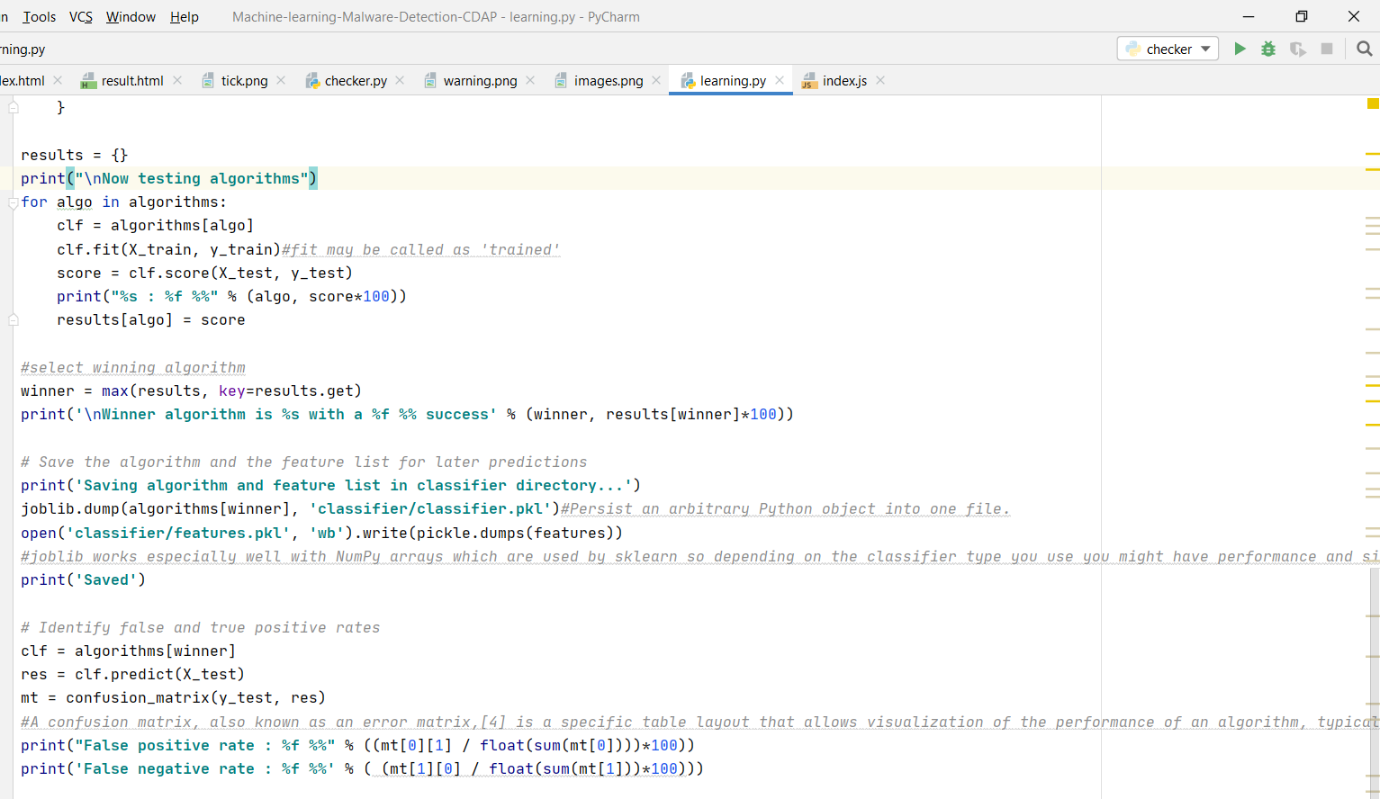

Slide 44
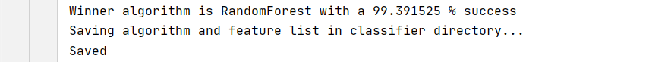
Random Tree algorithm was chosen as the most suitable or winning algorithm out of the five

Slide 45
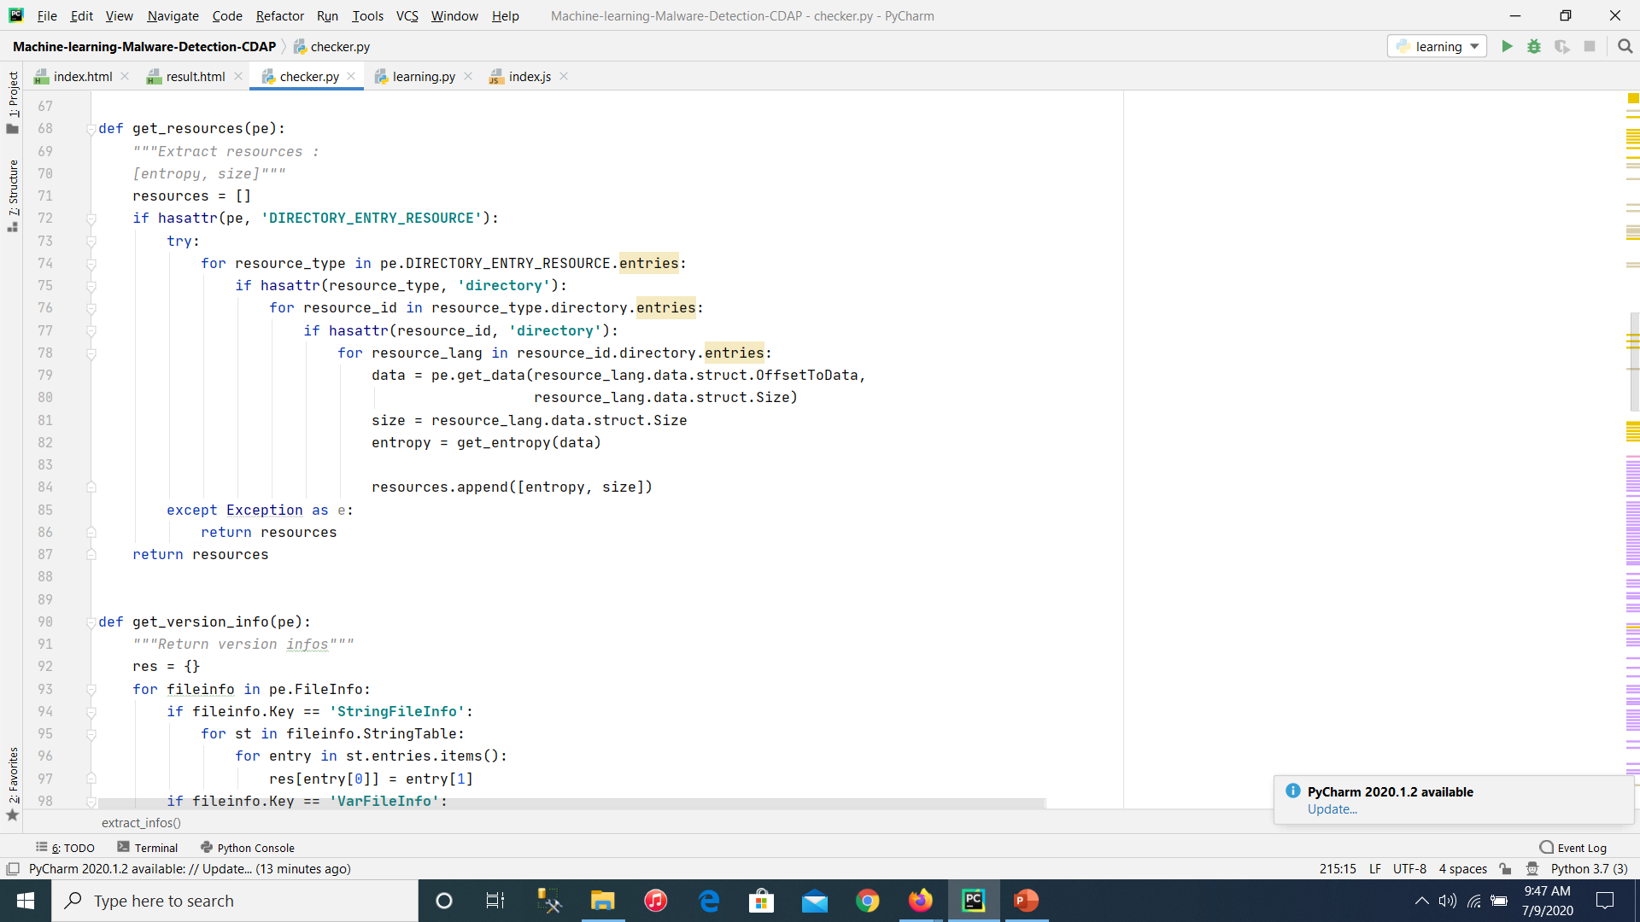
Once the winning algorithm was chosen then the next step was to implement how to check a given file using the machine learning model implemented. Therefore, the important features of the given file was extracted and checked against the file that user has given as input.

Slide 46
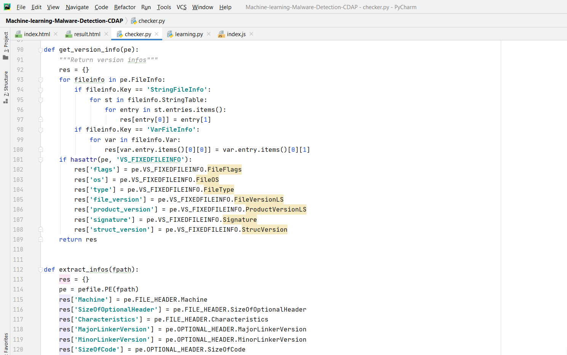

Slide 47
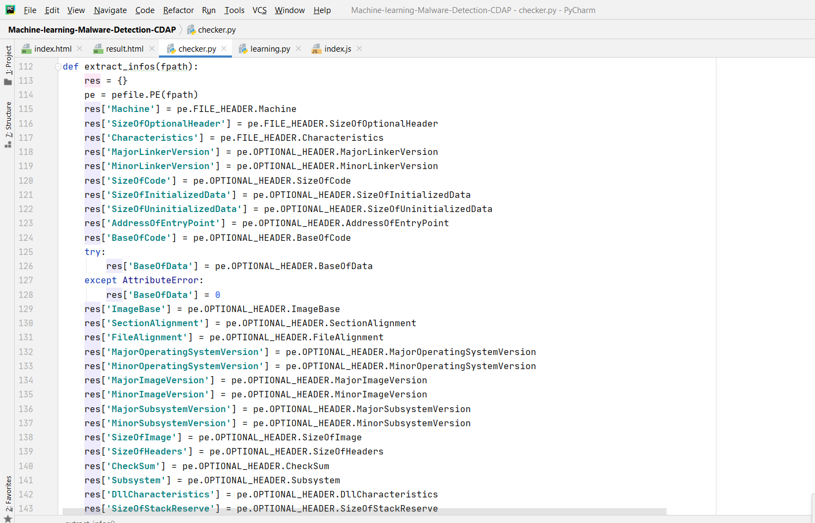

Slide 48
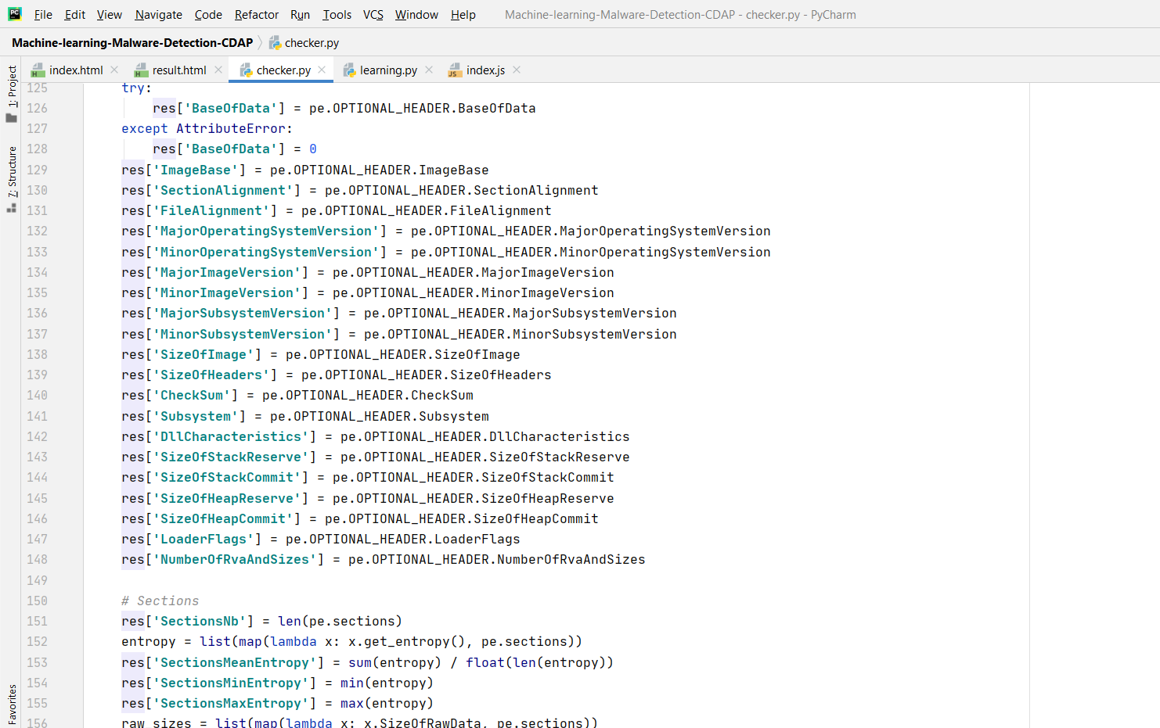

Slide 49
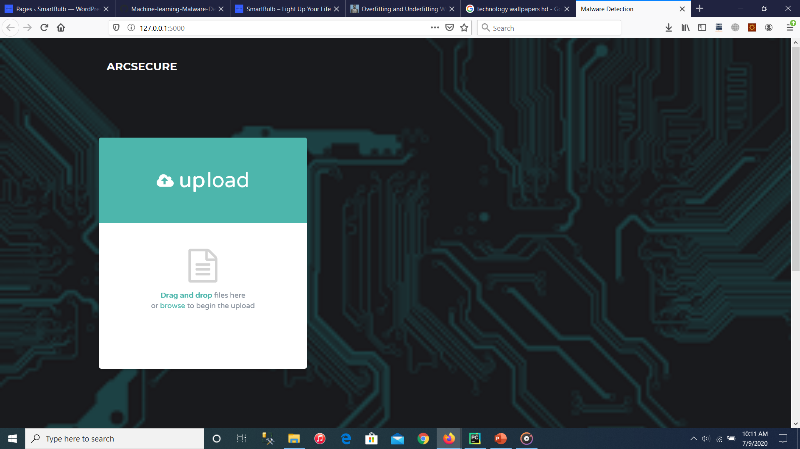
Then with the use of the ‘ARCSECURE’ web application and interface was created for the user to drag and drop the particular executable (.exe) file they have downloaded for the particular device and see if it a legitimate file or not.

Slide 50
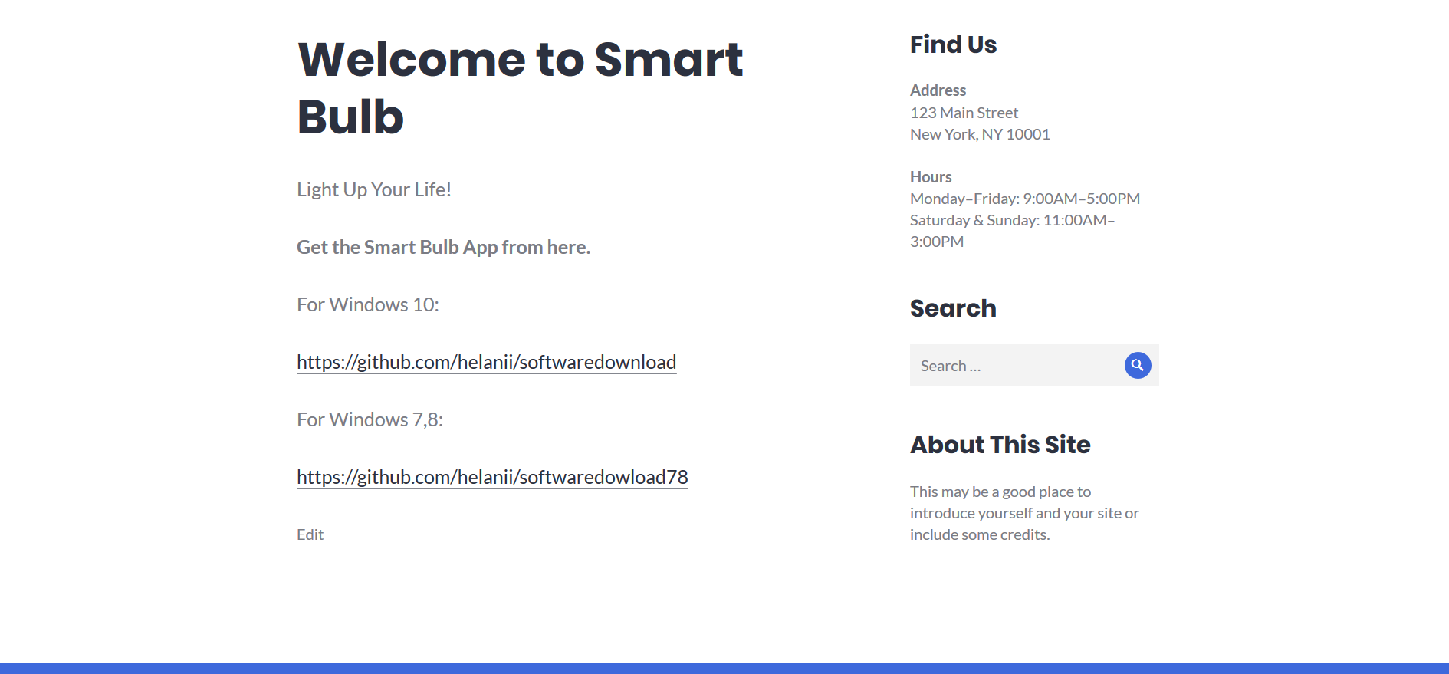
Once the file/files are uploaded the user can click on the ‘start detection’ button to get the particular result for instance I have hosted a website where two files are available for the device “Smart Bulb”. One of the files will be malicious and the other will be legitimate. (available on http://www.smartbulbwebexamp.ml/ )

Slide 51
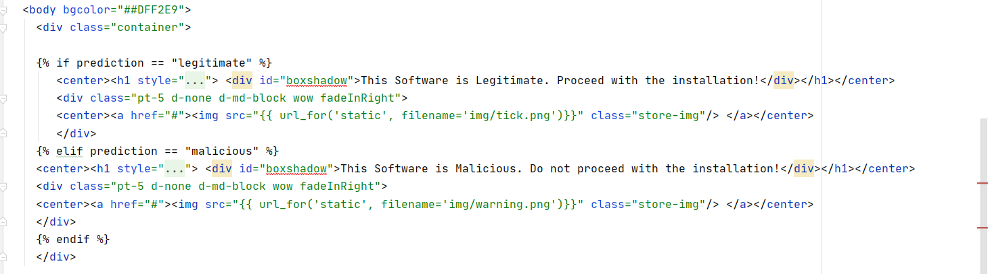
The two files will be “TestDummy.exe” and “TestDummy2.exe”. Once “Test Dummy2.exe” is dropped in to the ARCSECURE’s detection window the file is being detected as “Legitimate” and when “TestDummy.exe” is given as input, it shows that the particular file is “Malicious”.

Slide 52
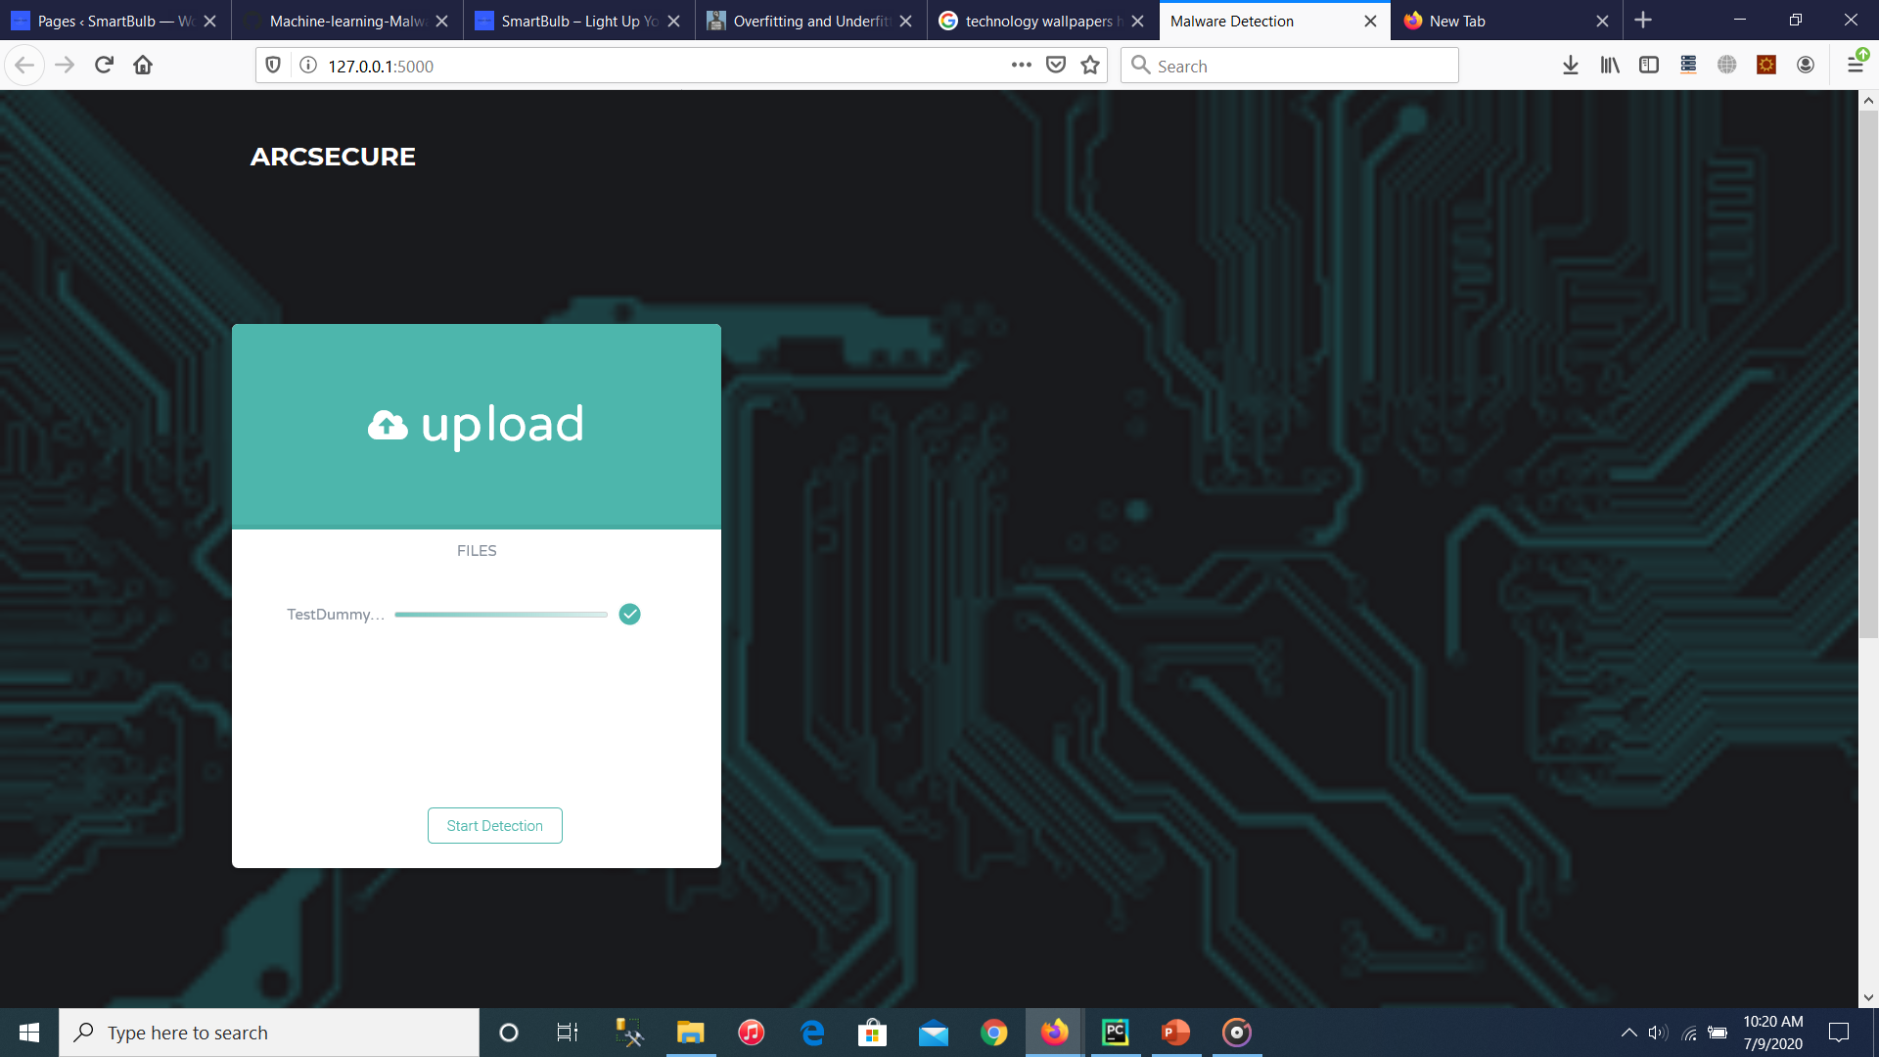
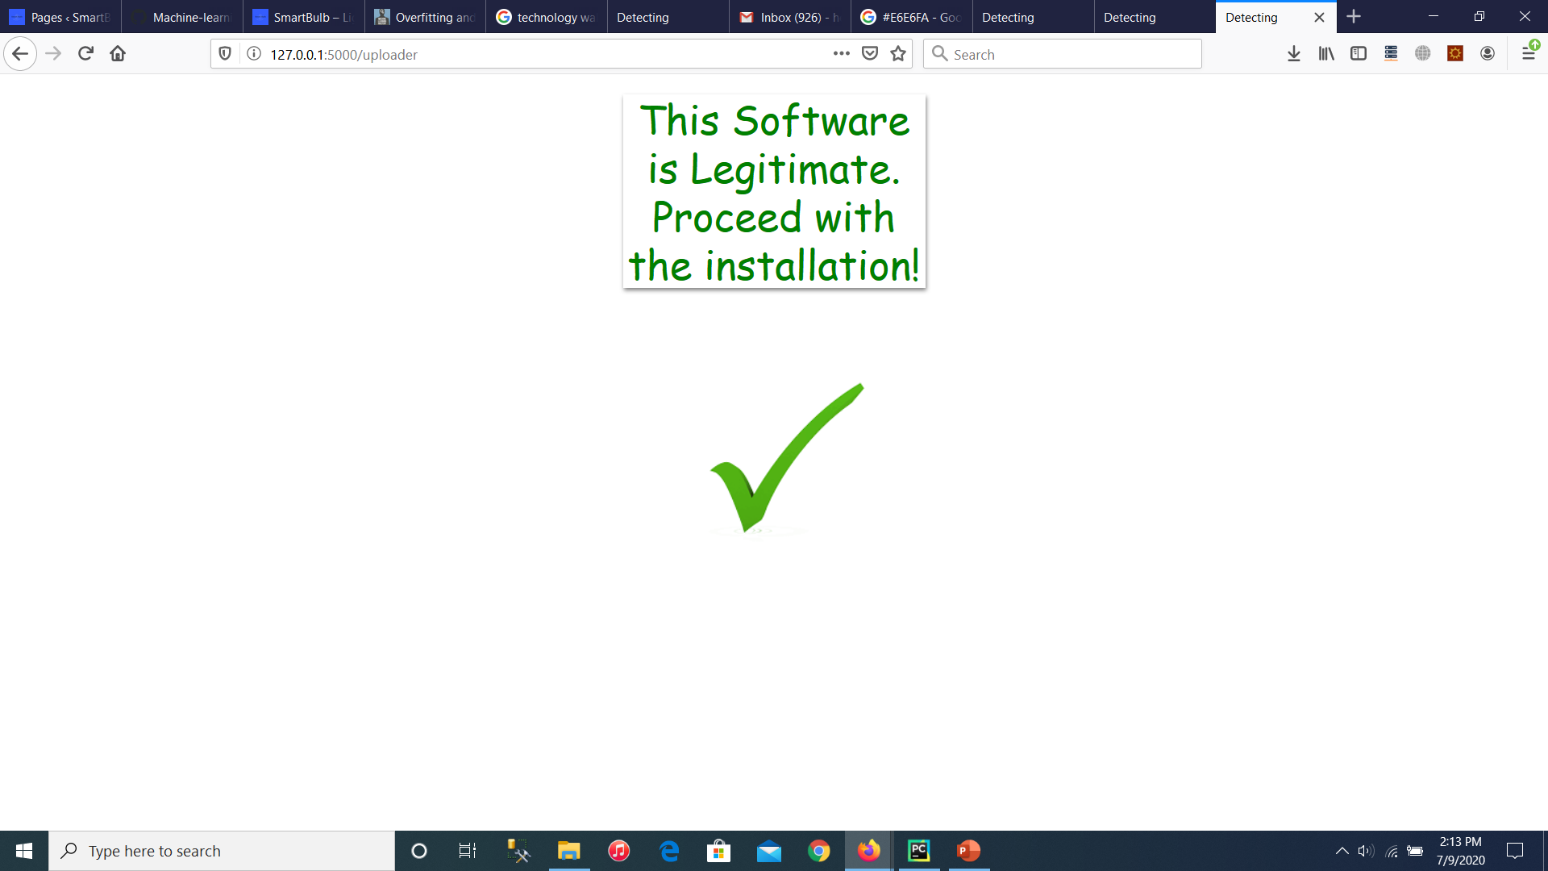

Slide 53
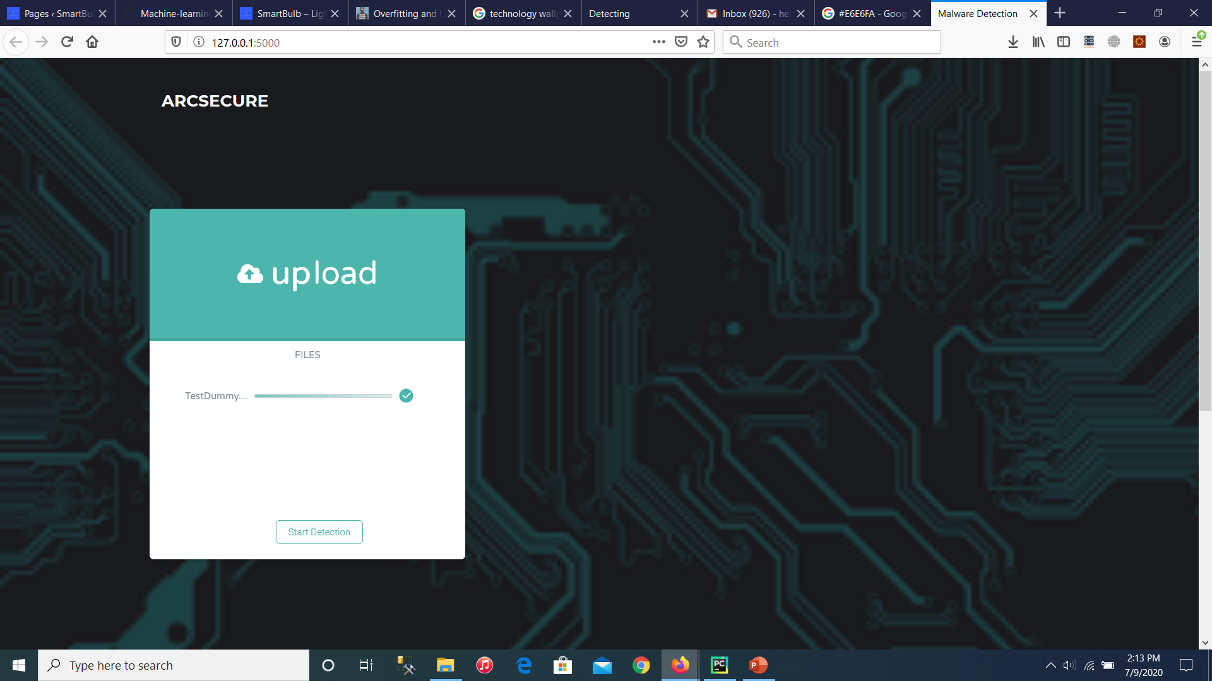
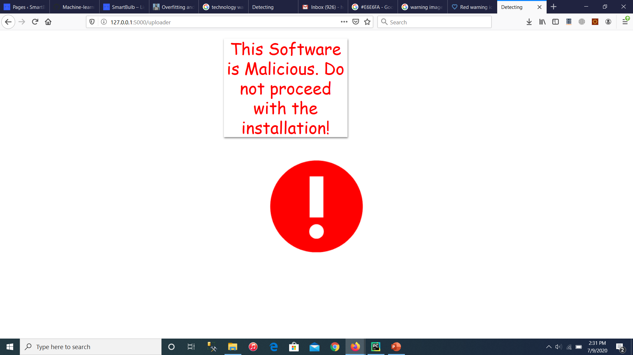

Slide 54
Current Achievements
Choose the best possible algorithm for implementation.
Finish coding (implementing) for the Machine Learning model.
Create necessary user interfaces for the web application.
Create a website to host the necessary .exe files for testing.
100% completion on training, testing and implementing ML.
100% completion on Implementing web application with the created Machine Learning model.

Slide 55
Milestone Progress

Slide 56
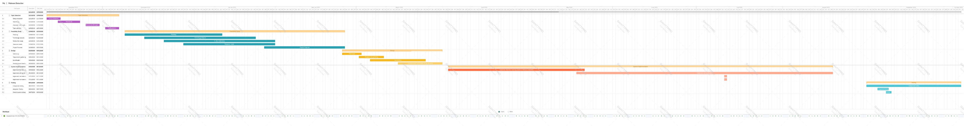
Milestone Progress

Slide 57
Secure User Authentication
Samarasekara C.N (IT17126816)

Slide 58
Secure User Authentication
Most IoT devices do not prioritize user authentication. The devices that do provide means of authenticating a user only accounts for basic authentication mechanisms.
Therefore, in order to overcome this an MFA (Multi Factor Authentication) mechanism will be implemented.
Keystroke Dynamics would be utilized with the aid of machine learning in order to scrutinize a user’s typing patterns. Thus adding an additional layer of protection in the event of credentials being compromised.

Slide 59
Technologies used
PyCharm IDE
Python
HTML
CSS
JavaScript

Slide 60
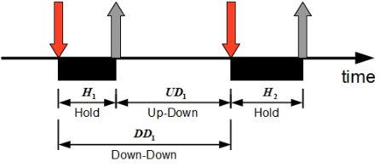
Typing Patterns Considered
Hold Time
Keydown - Keydown Time
Keyup - Keyup Time

Slide 61
Methodology and Implementation

Slide 62
Methodology
For this purpose 5 supervised learning algorithms were chosen. Namely,
K Nearest Neighbor
Logistic Regression
Decision Tree
Random Forest Classifier
Extra Tree Classifier

Slide 63
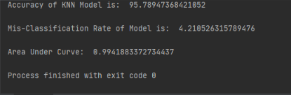
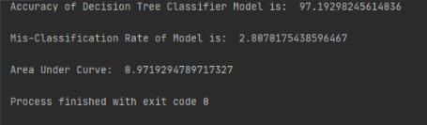
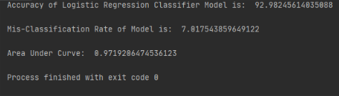

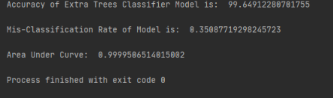


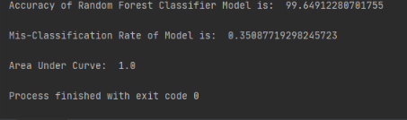
Accuracy Results

Slide 64
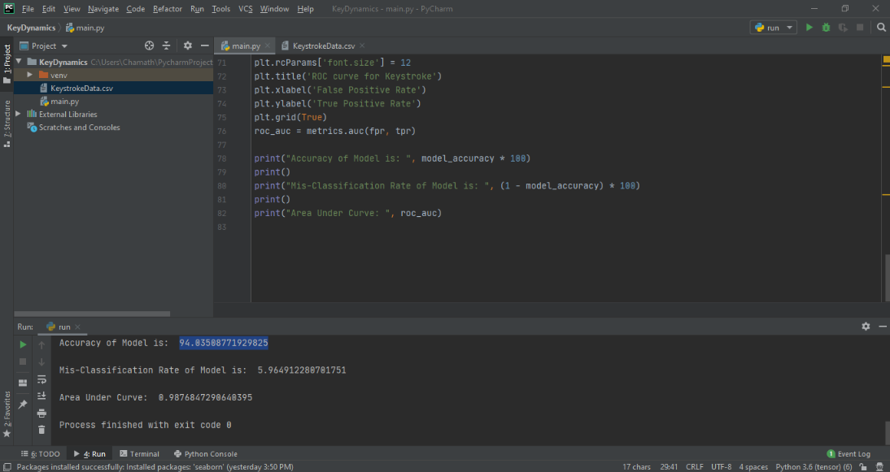

Slide 65
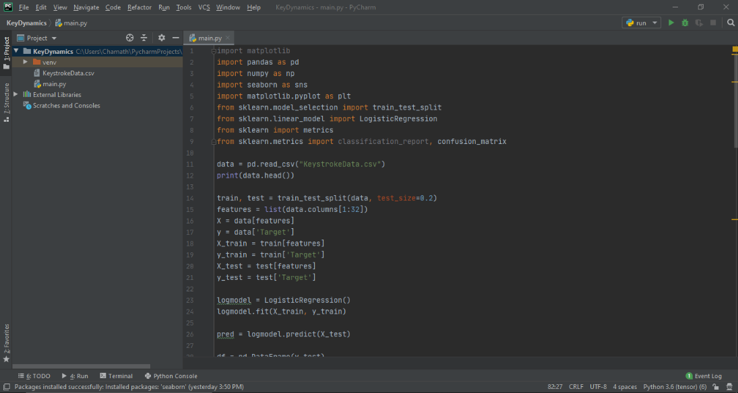

Slide 66
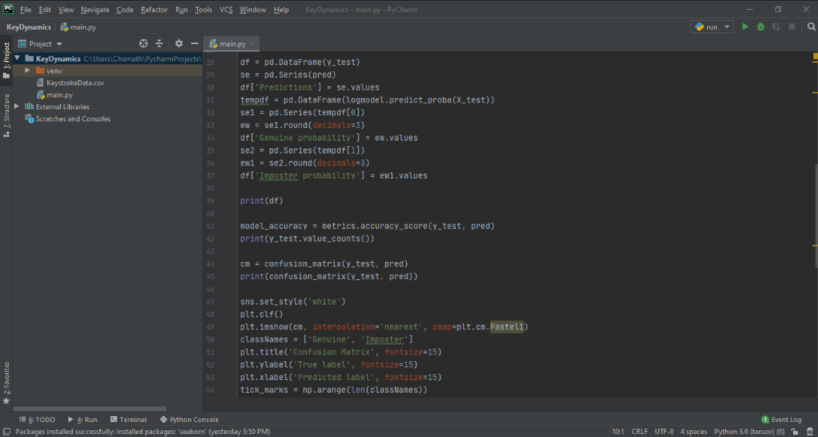

Slide 67
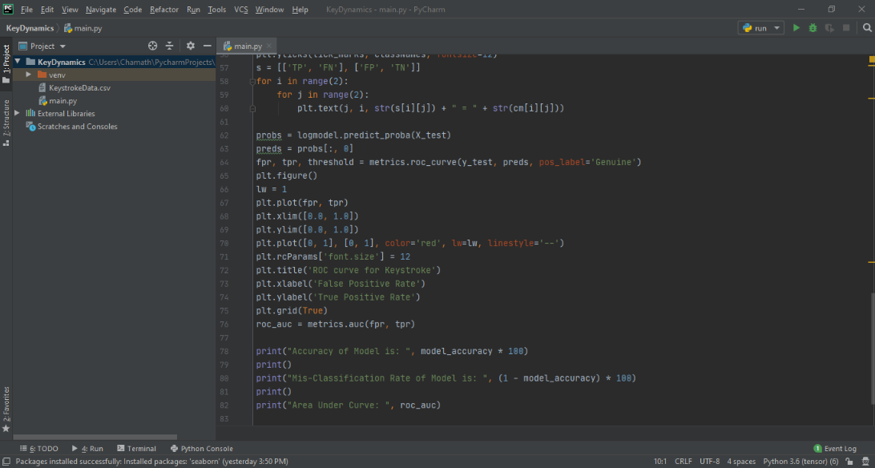

Slide 68
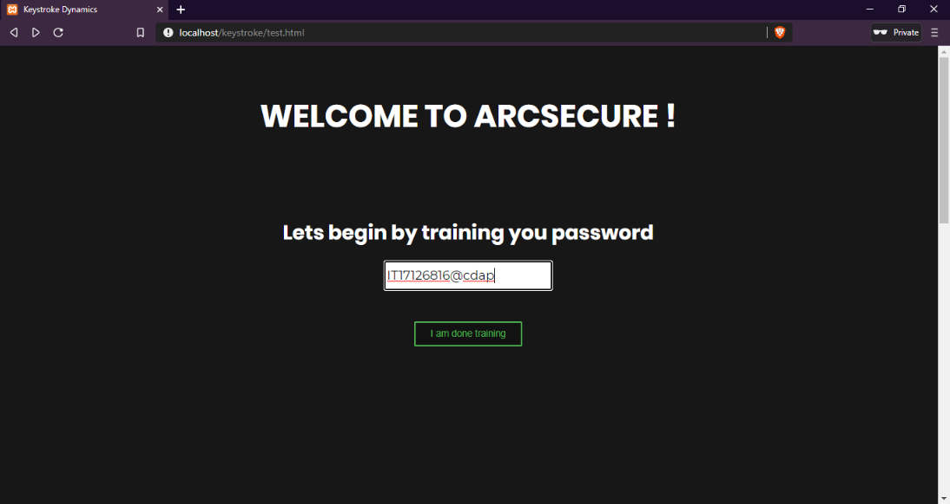

Slide 69
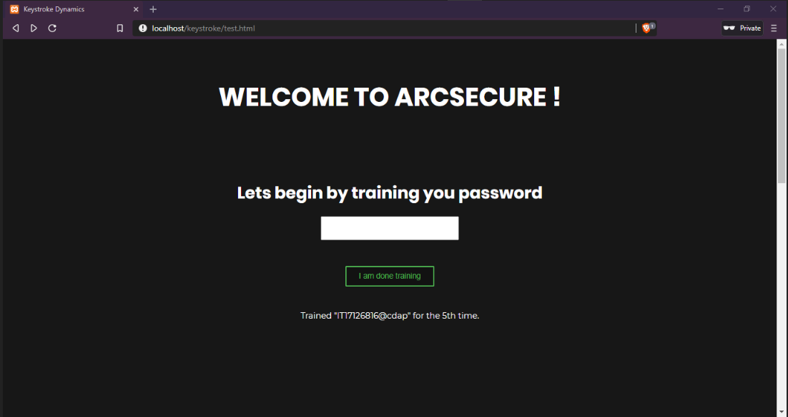

Slide 70
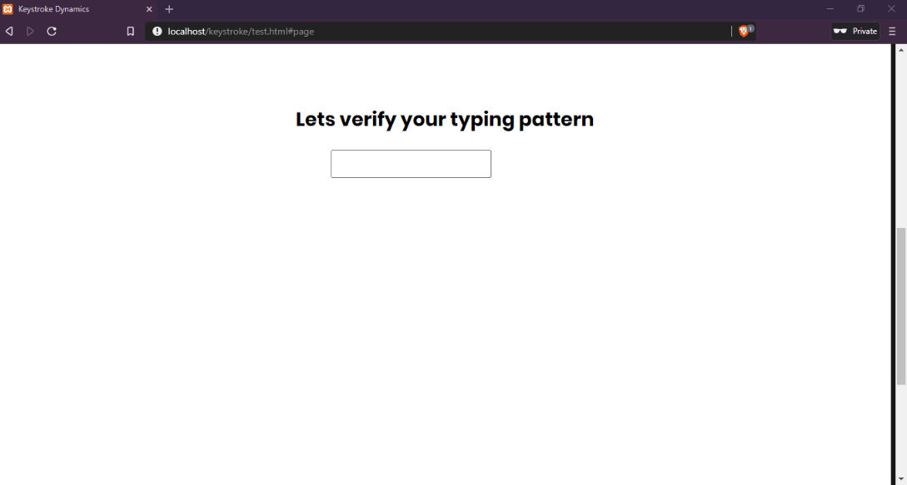

Slide 71
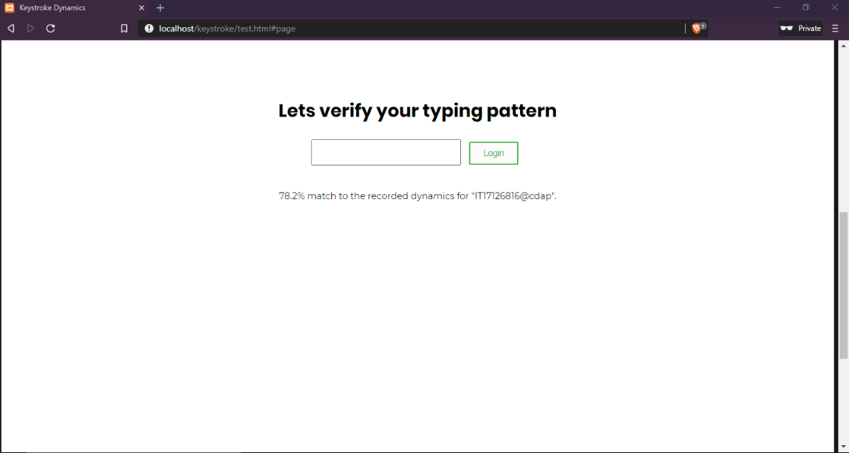

Slide 72
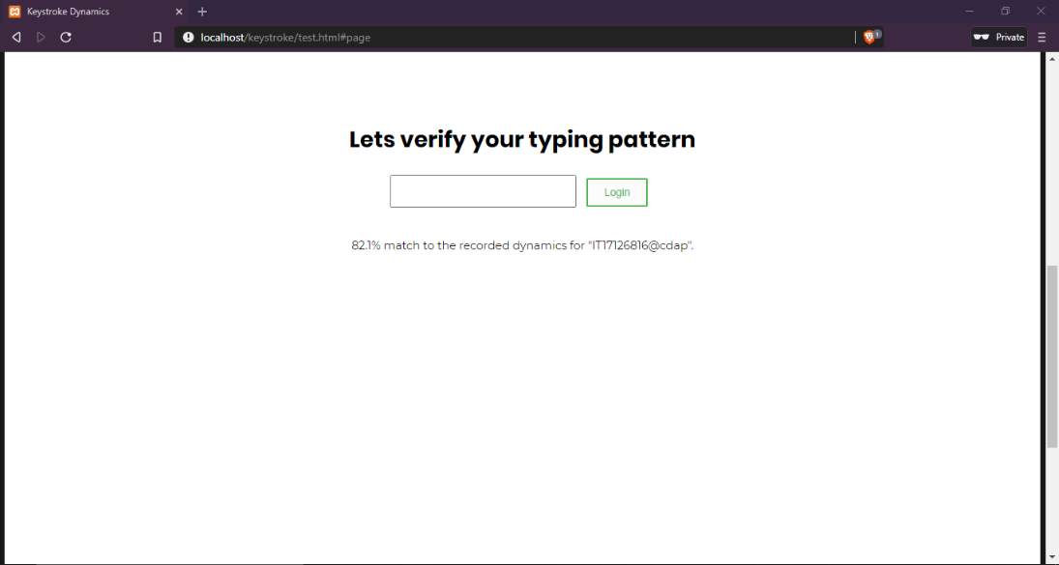

Slide 73


Slide 74
Current Achievements
Choosing the best possible algorithm for implementation.
Finish coding (implementing) the Machine Learning model.
Completion on training, testing and implementing the Machine Learning model.
Completion on testing a web application with the created Machine Learning model.

Slide 75

Thank you!

